Slide 1

EXCEL ENGINEERING COLLEGE
(AUTONOMOUS)
Approved by AICTE, New Delhi & Affiliated to Anna University, Chennai
Accreditated by NBA (AERO, CSE, ECE, MECH) , NAAC with “A⁺” and Recognised by UGC (2f &12B),KOMARAPALAYAM – 637303
DESIGN PROJECT FINAL PRESENTATION
DEPARTMENT OF ARTIFICAL INTELLIGENCE AND DATA SCIENCE
AGRIKNOW

Slide 2
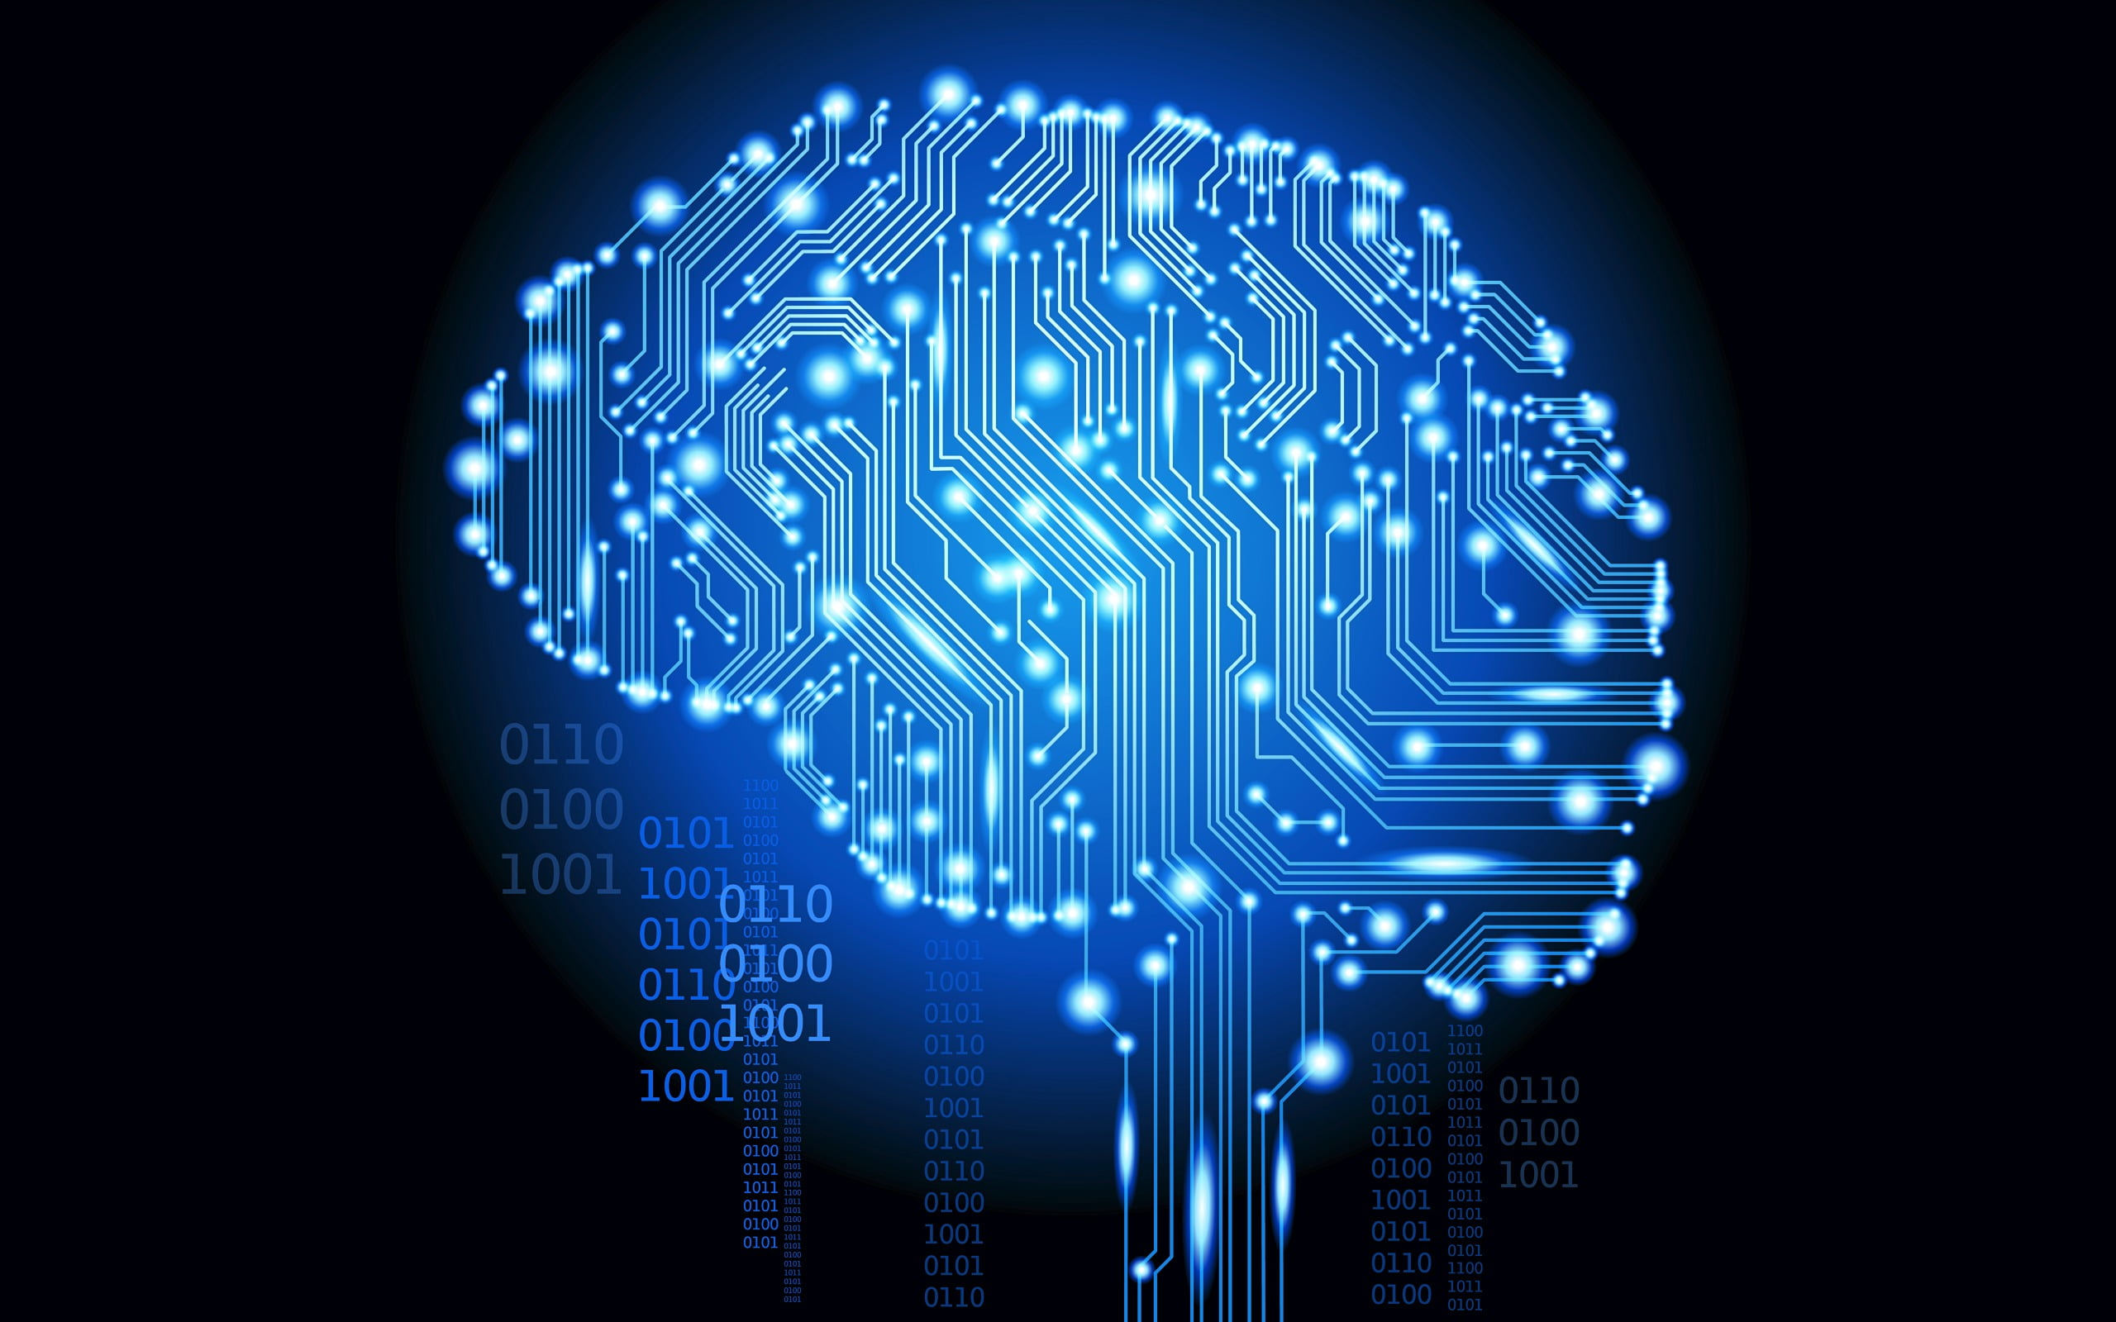
Title:
AI assisted web application agri- pratices and yield projection
Project guide
MRS. S.L. SWARNA
(ASSISSTANT PROFESSOR)
Team members:
AARIFF M
MOHAMED AQEEL M
THARUN ATITHYA B
BERBIN JOE J

Slide 3
CONTENTS :
INTRODUCTION
ABSTRACT
OBJECTIVE
EXISTING PROPOSED SYSTEM
SOFTWARES USED
PROJECT OUTLINE
MODULES
MODULE DESCRIPTION
CONCLUSION

Slide 4
OUR PROJECT
AYURVEDIC MEDICINE ADVISOR USING ML
ABSTRACT:
The project focuses on creating an Ayurvedic medicine advisor system that employs a random forest classifier to offer personalized recommendations for herbal medicine, diet, and lifestyle choices based on user-provided symptoms and health conditions. Utilizing a dataset derived from Ayurvedic classical books and repositories, the system preprocesses the data and trains the random forest classifier. The web-based interface enables users to input their symptoms, after which they receive tailored recommendations. This project merges the traditional wisdom of Ayurveda with modern machine learning techniques to deliver personalized health recommendations. By leveraging the random forest classifier, the system can analyze a wide range of symptoms and health conditions to provide holistic and individualized advice. This approach not only enhances the accessibility of Ayurvedic knowledge but also opens avenues for integrating traditional medicine with modern healthcare practices. Overall, the project signifies a significant step towards utilizing technology to preserve and promote traditional medicinal systems like Ayurveda

Slide 5

Objective of the project:
Enhance Accessibility and Dissemination of Ayurvedic Knowledge:
Develop a user-friendly platform that bridges the gap between traditional Ayurvedic knowledge and its accessibility to the general public.
Translate complex Ayurvedic principles into understandable information through a machine learning-powered symptom analysis and suggestion system.
Empower Users through Self-Care Education:
Foster informed decision-making by providing users with:
Potential disease identification based on symptom analysis.
Personalized dietary recommendations aligned with Ayurvedic principles.
Educational content on relevant Ayurvedic concepts and practices.
Equip users with the knowledge and understanding to take a proactive approach to their well-being and self-care through Ayurveda.
Prepare users for productive consultations with qualified Ayurvedic practitioners.

Slide 6
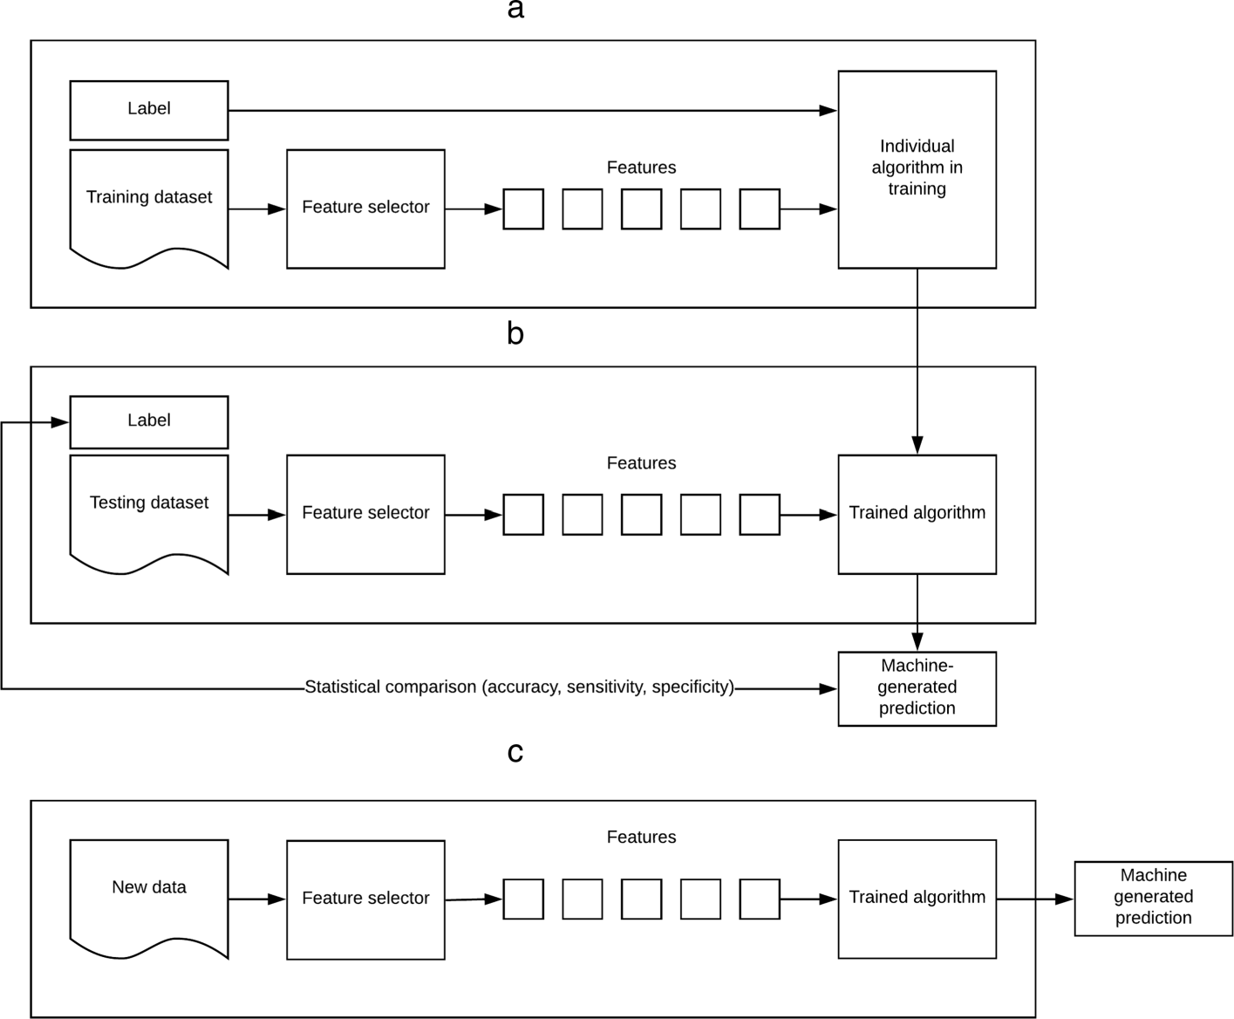
EXISTING PROPOSAL METHOD :
Heart Disease Prediction: This is a common example where researchers have explored using machine learning models to analyze various factors like age, blood pressure, cholesterol levels, etc. to predict the risk of heart disease. Different algorithms like Support Vector Machines (SVM) or Logistic Regression have shown promising results in identifying individuals at higher risk.
Cancer Detection: Machine learning is being investigated for analyzing medical images like mammograms or X-rays to detect potential signs of cancer. Techniques like Convolutional Neural Networks (CNNs) have been used to achieve high accuracy in identifying cancerous tumors in these images.

Slide 7
SOFTWARE USED
FRONT END
HTML
CSS
Flask
MODULES
Scikit Learn
Pandas
Numpy
Spacy
Fuzzywuzzy
Joblib
Xgboost
AssemblyAI
JSON
CHALLENGES
Dataset collection
Underfitting
Overfitting
BACKEND END
PYTHON
DATASET SOURCE
Kaggle(Noor saeed)
DEVELOPMENT TOOLS
Pycharm
Jupyter
Github
Powerbi

Slide 8
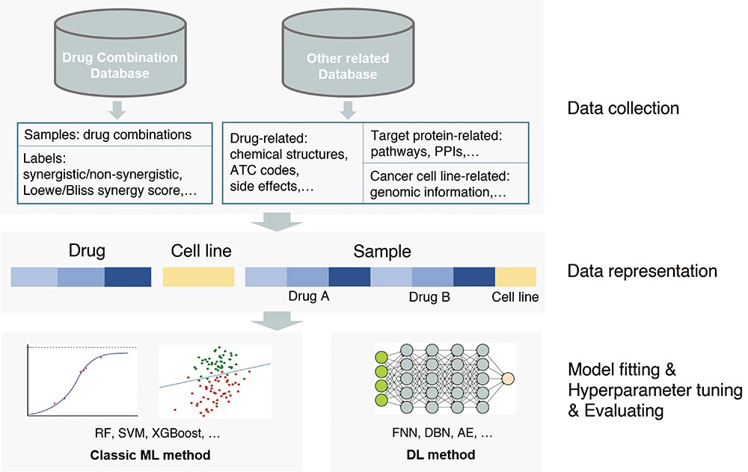
PROJECT OUTLINE
Personalized Recommendations: Building upon the suggested diagnoses, the system will provide users with personalized recommendations tailored to Ayurvedic principles. These recommendations may encompass:
Treatment Considerations: Information on potentially relevant Ayurvedic herbs or formulations, with a clear disclaimer that the system does not prescribe or recommend dosages.
Dietary Guidance: Personalized dietary recommendations aligned with Ayurvedic practices to promote balance and healing within the body.
Lifestyle Modifications: Suggestions for Ayurvedic lifestyle modifications and yoga practices (if applicable) that can support overall well-being.

Slide 9
MODULE DESCRIPTION
1. Machine Learning (scikit-learn):
Trains the model to analyze symptoms and predict diagnoses.
2. Natural Language Processing (spaCy):
Processes user-provided text descriptions of symptoms.
3. Text Similarity (fuzzywuzzy):
Handles variations or typos in symptom descriptions.
4. Model Persistence (joblib):
Saves and loads the trained machine learning model.
5. Speech Recognition (AssemblyAI):
Converts spoken symptoms into text.
6. Data Science (NumPy, Pandas):
Numerical computing and data manipulation for machine learning.

Slide 10
CONCLUSION
Successfully developed an AI-powered Ayurveda medicine advisor that provides personalized health advice based on user symptoms. Integrated machine learning algorithms to analyze symptoms and recommend Ayurvedic treatments.
Created a user-friendly interface for easy symptom input and access to health recommendations. Overcoming challenges in data collection, model training, and software development. Gained insights into Ayurvedic principles and their application in modern healthcare. The Ayurveda medicine advisor project represents a significant step towards leveraging AI for personalized healthcare. The project aims to make Ayurvedic healthcare more accessible and personalized, catering to individual health needs. Provides users with holistic health recommendations, including diet, lifestyle changes, and herbal remedies. It showcases the potential of combining traditional medical knowledge with modern technology to improve health outcomes. Acknowledge the contributions of team members, mentors, and any external support received during the project.

Slide 11
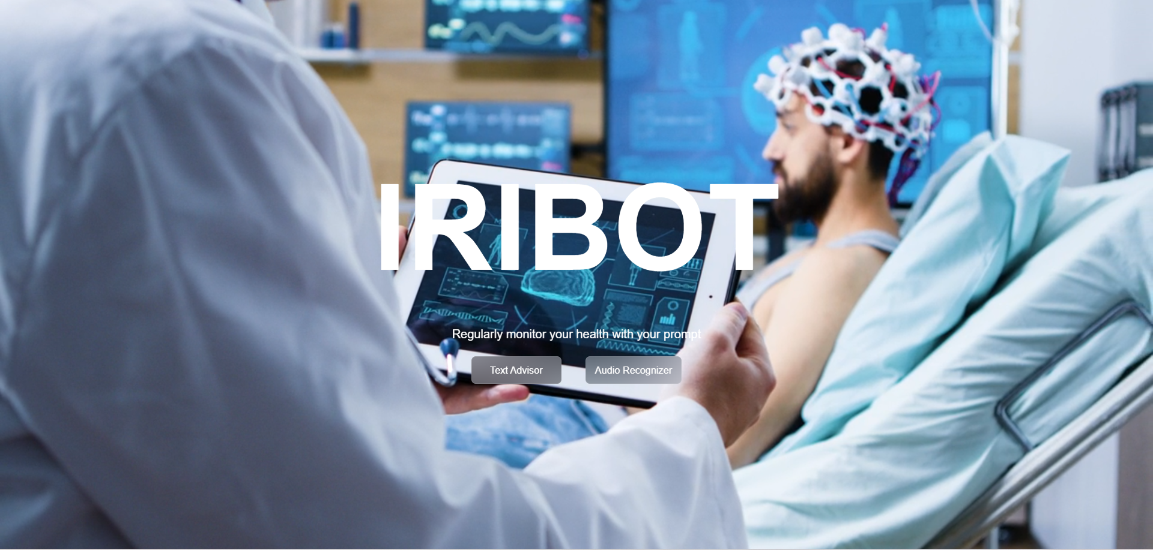
IRIBOT
HOME SCREEN

Slide 12
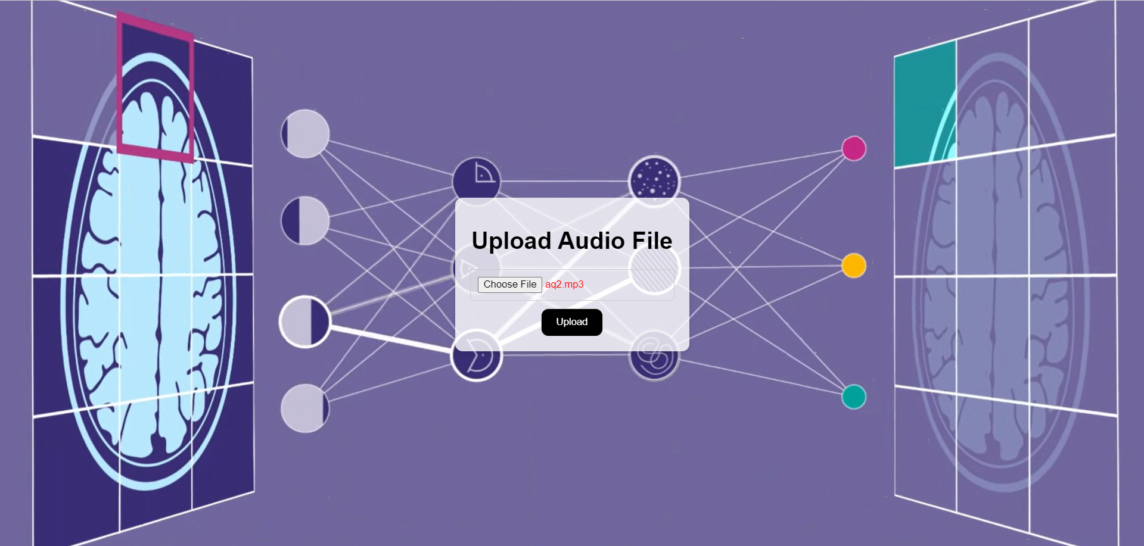
IRIBOT
AUDIO ANALYZER

Slide 13
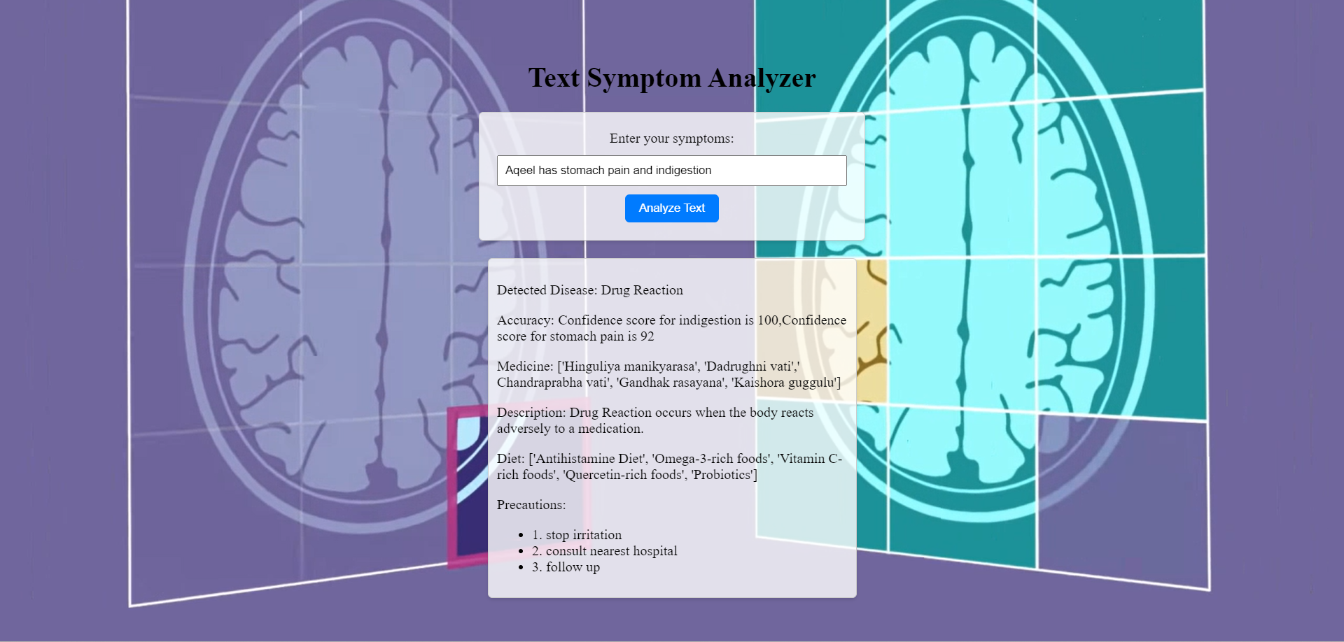
IRIBOT
TEXT ANALYZER

Slide 14
THANK YOU

